Slide 1


/cover

Slide 2
/index
LOG IN
SIGN UP
Copyright @ Team GuageLander 2019

Slide 3




/login
Explore a new language every day!
Email
Password
LOG IN
Or Log in with

Slide 4
/signup
Welcome to GuageLand!
Email
Password
Re-enter Password
SIGN UP

Slide 5





5 main pages:
Findings
Chatbots
Discovery
Personal Land
Profile
Findings
TODAY’S POPULAR
/findings

Slide 6


Chatbots
Hi, How can I help you?
/chatbot
How can I use my points?
You can use them to claim reward…
………..
oh that’s easy…..

Slide 7


Discovery
10234 Indigenous Languages
in our GuageLand
/discovery

Slide 8



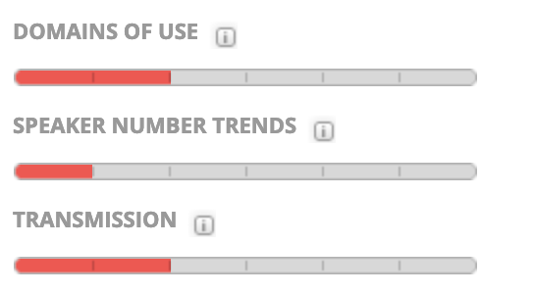
Language Profile
61
Articles
Related
302 Languages
Viewed
[Language Name]
When click their profile images in the Findings’ article
Malaysia
Severely Endangered
Also known as:
Classification:
Orthography:
Code Authority:
Language Code:
MAP Picture
Location:
/languages/Southeast_asia/Malaysia/Language_A
Co-ordinate: (a, b)
Latest Related Post
1, 500 years
History
7, 000 People using it
/Navajo Word of the Day - "I Love You”

Slide 9
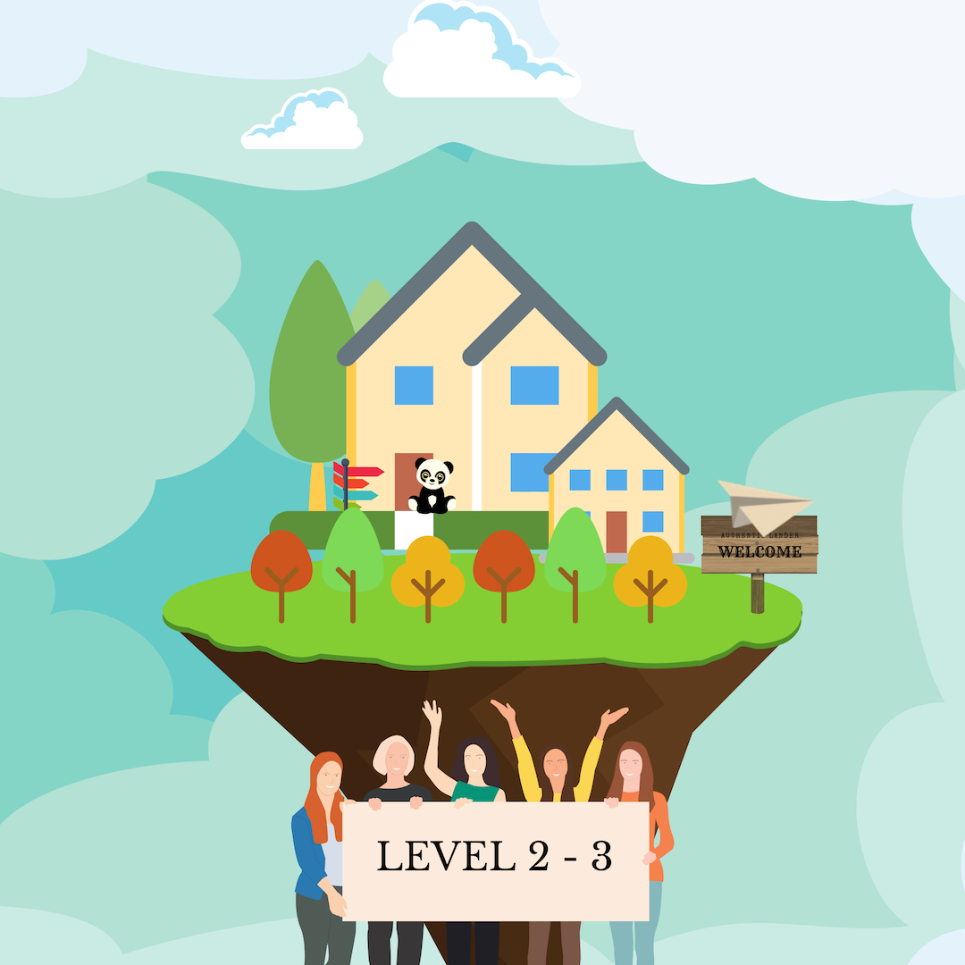


Your Guageland Lv 6
Personal Land
Your Guageland Lv 6
/user_1/land
200
Lvl up
pic of non-passed levels, pic grey out, add lock
pic of each level has passed

Slide 10

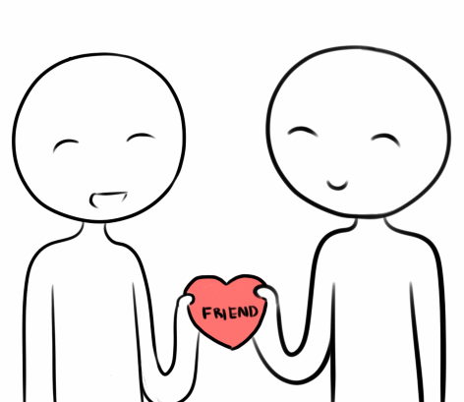


Profile
Alice Lee
Lv. 6
/user_1/profile
Tasks
Favorites
Circles
My Posts
Rewards

Slide 11



Profile
1
Albi
Bulgri
Basic Info
/user_1/profile/info
Current Viewing Language
Expert Lv 7
Alice Lee
200
$ 500
Donation
3 Trips
Claimed
Signature
Build the shape of language.
Region
Singapore
45 Countries
Footprint
302 Languages
Viewed
Who views your profile

Slide 12

Profile
1
1
Unread Msg
Unread Message
/user_1/profile/info/msg
Yesterday 14:23
Alice Lee
Robot sends you a Friend Request!
200
Signature
Build the shape of language.
Message Received
Region
Yesterday 09:23
Singapore
Welcome to Guageland!
Who views your profile

Slide 13
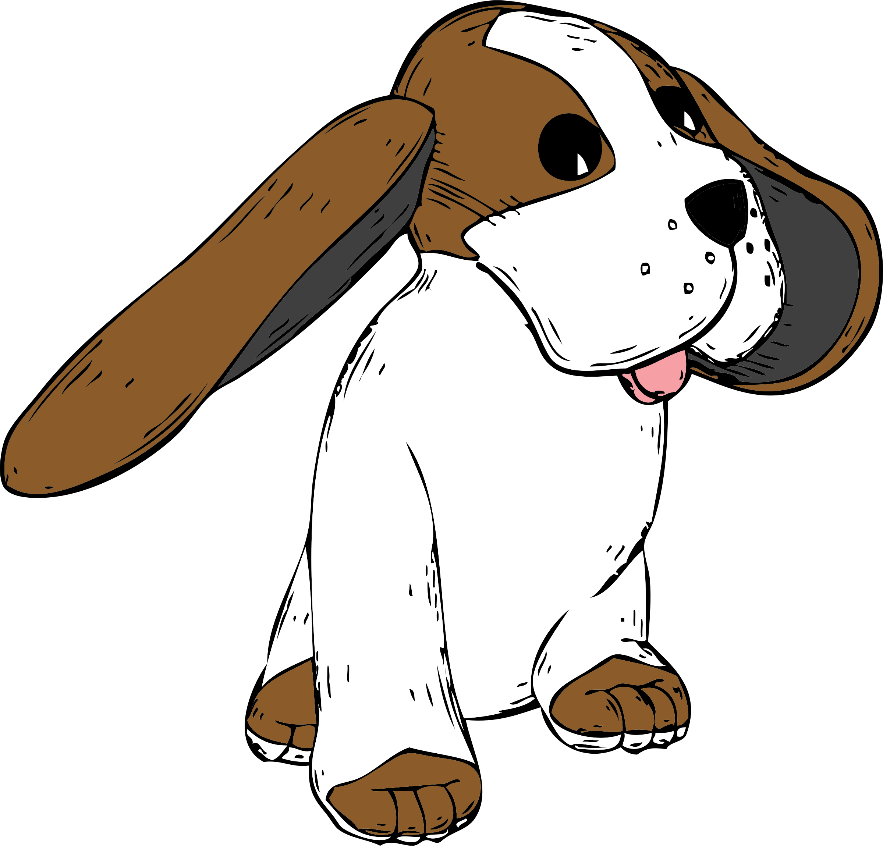

+
Other Users’ Profile
$ 500
Donation
3 Trips
Claimed
When click their profile images in the Findings’ article
Send Friend Request
45 Countries
Footprint
302 Languages
Viewed
Bob John
Malaysia
/users/Bob_john/profile
Build the shape of world!
Caldse
Xseus
His Latest Post
Current Viewing Language
Beginner Lv 2
/Navajo Word of the Day - "I Love You”

Slide 14


Other Language Organizations’ Profile
Organization
LOGO
$ 499,324
Donation Received
536
Article
Posts
(Follow)
When click their profile images in the Findings’ article
Latest Post
Endangered Language Project
http://www.endangeredlanguages.com
Supporting and celebrating global linguistic diversity!
/Navajo Word of the Day - "I Love You”
/orgs/elp/profile
Introduction
feedback@endangeredlanguages.com
The Endangered Languages Project puts technology at the service of the organizations and individuals working to confront the language endangerment by documenting, preserving and teaching them.
N/A
N/A

Slide 15


Profile
<
<
200
Tasks on Your Land
Task
Chat with Bot Twice
50
200
Make 2 new friends
/user_1/profile/tasks
100
Paper plane Wandering
15
Tasks Completed
Quiz
30
Daily Attendance
16 March 2019
10
Sharing your language
100
Chat with Bot Twice
50

Slide 16
<
Profile
Favorites
4
Favorites
/user_1/profile/favorites
Post 234 of Language A
Post 456 of Language b
Post 789 of Language D
14/05/2018 Chat History

Slide 17

<
<
Profile
5
/Navajo Word of the Day - "I Love You”
Since today is Valentine's Day, I decided to make today's Navajo Word of the Day
"Ayóó'ánííníshní,”
which means,
"I Love You!"
Favorites
Circles
Today’s share
Today
14:13
/user_1/profile/circles
<
<
/profile/circles/article_1
User pic who posts
/Navajo Word of the Day - "I Love You”
when click
when click

Slide 18
Profile
Circles
/Navajo Word of the Day - "I Love You”
____________
Since today is Valentine's Day, I decided to make today's Navajo Word of the Day
"Ayóó'ánííníshní,”
which means,
"I Love You!"
/Navajo Word of the Day - "I Love You”
____________
Since today is Valentine's Day, I decided to make today's Navajo Word of the Day
"Ayóó'ánííníshní,”
which means,
"I Love You!"
/user_1/profile/circles/article_1
< Your Friends
when click
the forward button

Slide 19

Profile
<
<
Quiz
QUIZ
QUIZ
Count down
Picture
A
B
/quiz/question_1
Question 1
C
D
A
B

Slide 20


Profile
<
200
/user_1/profile/rewards
Rewards
We have 9 rewards kinds:
50 points,
100 points,
200 points,
500 points,
1000 points,
2000 points,
5000 points,
10000 points
15000 points
50 points
100 points
200 points
10000 points
15000 points
Notes:
dark blue 203864

